Slide 1
Club foot
DOris Linguya

Slide 2
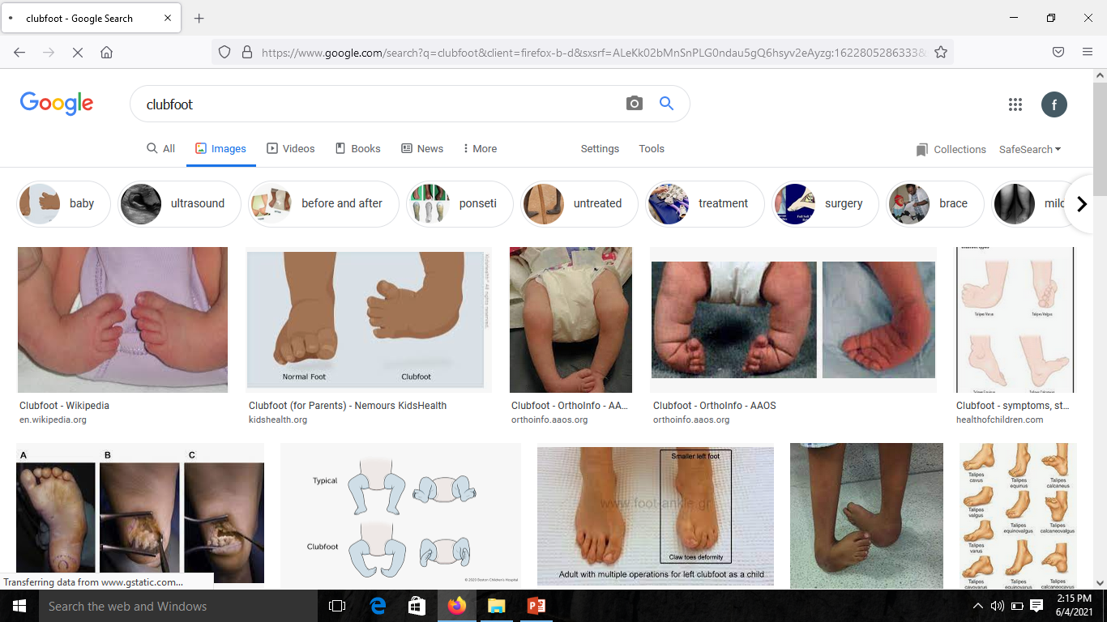

Slide 4
definition
Is birth defect where one or both of the feet are inward rotated and downward.
The affected foot looks smaller than the normal one.
Approx. 50% of the cases affect both feet.
The diagnosis is basically made during birth or fetal life.
It occurs in1 to 4 of every 1000 live births
Club foot is most common congenital defects affecting the legs.
Common in males than in females

Slide 5
Associated condition
Arthrogryposis.
myelomeningocele

Slide 6
Cause of club foot not well understood the following theories have tried to explain most probable causes.
Classified as idiopathic club foot and secondary club foot.
Idiopathic is related to
Mechanical theory
Ischemic theory
Genetic theory

Slide 7
Secondary club foot.
Follows some of this causes.
Paralytic disorders-e,g in polio
Arthrogryposis multiplex congenital.

Slide 8
pathoanatomy
Let first understand the anatomy of the foot
JOINTS OF THE FOOT.
The tibia fibula articulating with the talus.
The subtalar joint.
Talonavicular joint.
Calceneo-cuboidal joint.

Slide 9
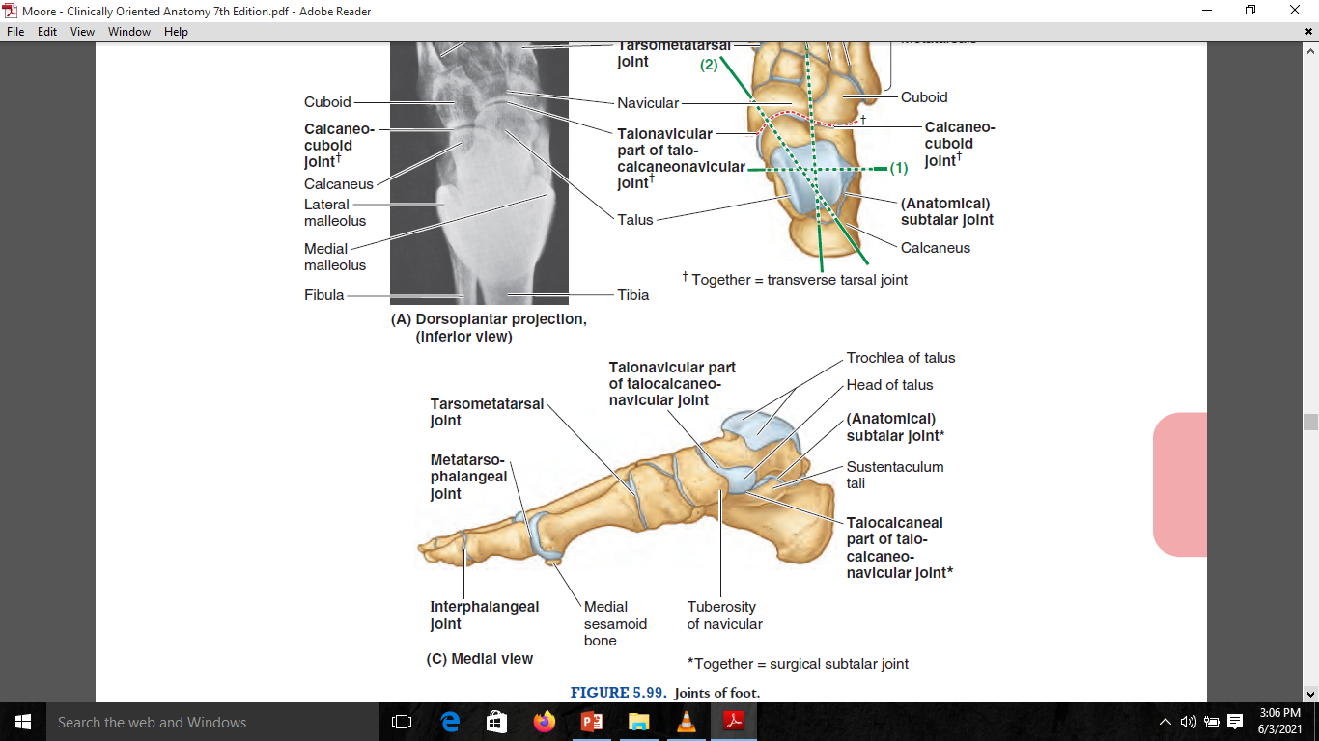

Slide 11
Foot divisions
Hind foot-comprising the talo-calcaneal and calcaneal-cuboidal joints
Mid foot-comprise of talo-navicular and navicular-cuneiform joints.
Forefoot.-composed of cuneiform-metartarsal and other joint beyond that.

Slide 12
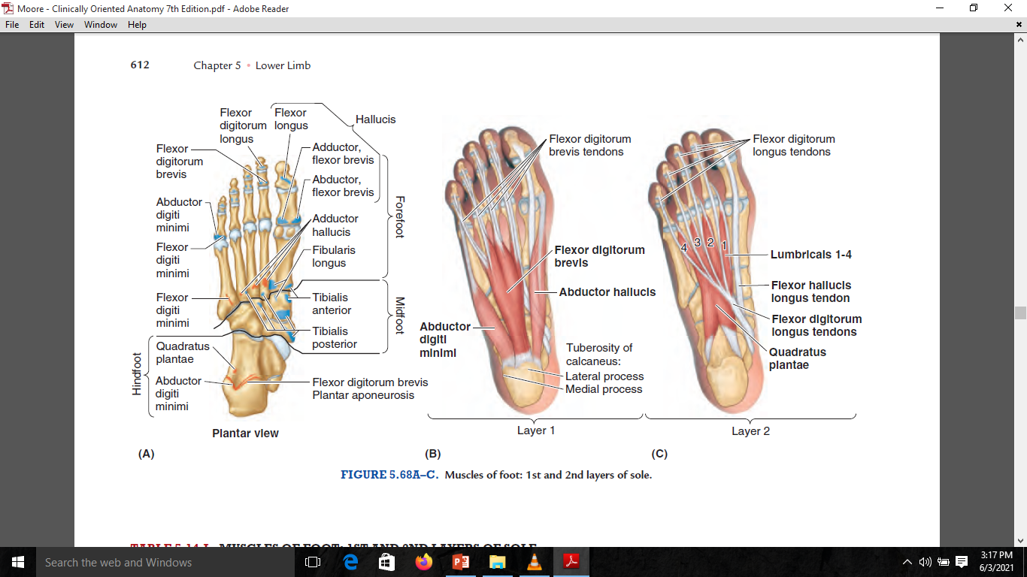

Slide 13
Plantar ligament
These are ligaments extending from the plantar surface of the calcaneus to the the parts of the foot
The include the following.

Slide 14
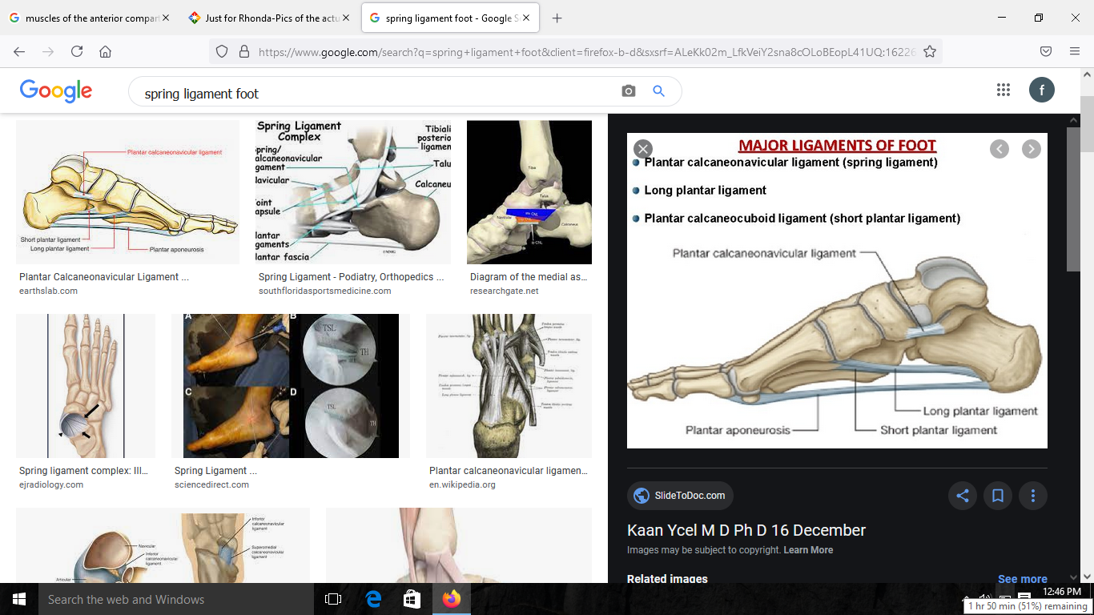

Slide 15
Tendons associated with the pathology of the club foot.
The muscle tendon associated with the pathology of the club foot are posterior compartment of the leg
Superficial group-they form the Achilles tendon
Deep group-tibialis p
Flexor digitorum longus .
Flexor hallucis longus.

Slide 16
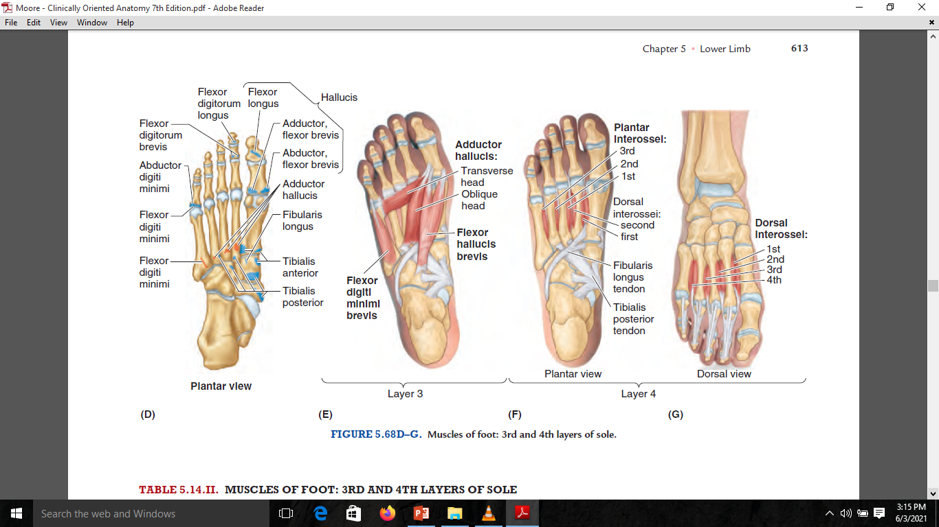

Slide 17
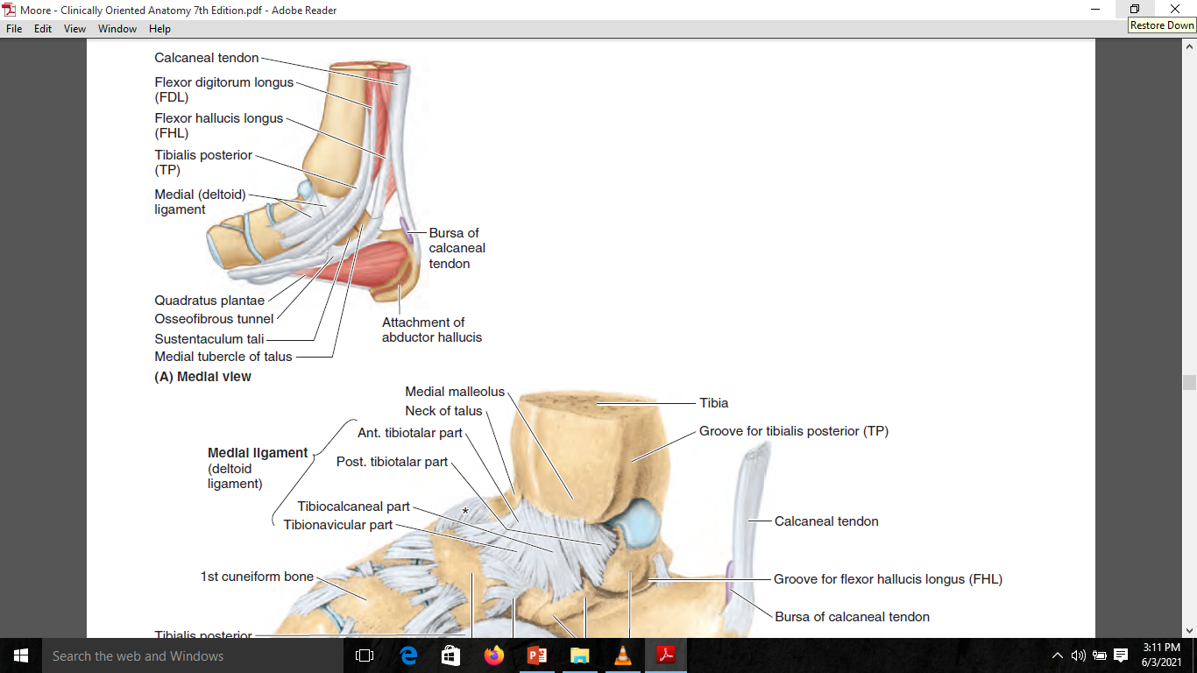

Slide 18
Pathoanatomy of the club foot.
Mostly the club foot occur when all these structures have the abnormality.
BONES
The bones of the foot are smaller then normal
The neck of the talus is angulated so that the talus faces downwards and medially
The calcaneal bone is small and convex.

Slide 19
Joint deformities.
Equinus-this deformity occurs primarily at the ankle joint.
Inversion-deformity occurs primally at the subtalar joint. The inverted calcaneus take the whole foot with its so that the sole faces medially.
Fore foot adduction deformity occurs at the mid tarsal joints ,mainly at talo-navicular joint.
Forefoot cavus-deformity is the result of the excessive arching of the foot at the mind –tarsal joints.

Slide 20
Tendons.
Tight Achilles tendons.
Tight- tibialis posterior.
Flexor digitorum longus
Flexor halluces longus.
CAPSULES AND LIGAMENT
Posteriorly-posterior capsule of the ankle joint.
Posterior capsule of the subtalar joint.

Slide 21
ligament
Medially-
talonavicular ligament
Deltoid ligament.
Spring ligament.
Plantar region
Plantar ligament
Plantar ligament

Slide 22
skin
The skin develops adaptive shortening on the medial side of the sole .
There is deep crease the medial side
CLINICAL FEATURES
Mostly noted during birth or during infancy
Present with deformity of the foot

Slide 23
On examination
Do general examination of the patient.
Foot examination the following finds are noted.
Bilateral foot deformity in about 60% cases.
The size of the foot smaller
The foot is in equinus ,Varus and adduction
Heel is small in size.
Deep skin crease.
Bony prominences are palpated on the left side of the foot.

Slide 24
Outer side of the foot is convex
Treatment.
Treatment of club foot involves
Operative and non operative.
Non operative management.
Manipulation alone.
Manipulation and pop
kites' method-adduction-inversion-equinus

Slide 25
Ponsett's method.
Operative methods
Postero-medial soft tissue release
Limited soft tissue release
Dwyer’s osteotomy-done at 3 years of age.
Dilwyn Evan's procedure –done in recurrent club foot at 4-8 years.
Triple arthrodesis-fusion of the subtalar, calcaneal-cuboidal and talonavicular.done at 12 years

Slide 26
Methods of maintenance of the correction.
CTEV Splints
Denis –brown splint
CTEV Shoes.

